Slide 1
Water Level Detector
(A story of an IoT device)
Kirk Carlson
kirk.carlson@att.net
https://github.com/kirkcarlson

Slide 2
About Me
retired telephony software engineer
  switches, key systems, cellular networks
messed with X-10 home automation
lately into data collection and display
  MQTT, openHAB, SmartiPi kiosks
love the raspberry pi
  Unix/Linux for 40 years

Slide 3
Motivation
measure lake level
capture "events" (beaver dam failure or seiche)
nice to find period and height of waves
nice to find information about wakes?
  how many
  how often
  how big (height?, period?, duration?, power?, energy?)

Slide 4
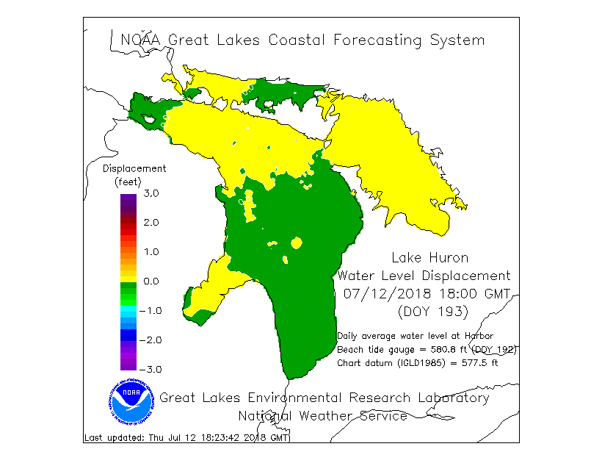
Lake Huron Sloshing
https://www.glerl.noaa.gov/res/glcfs/ncast/hwl.gif

Slide 5
Requirements
range: +/- 2 feet
continuous measurement
fairly decent resolution, say .1"
for a wave of 1 second, would like 16 samples
electronics must be kept dry

Slide 6
Selection of sensor
pressure transducer
ultrasonic
float and shaft encoder
water column pressure
radar
lidar (time of flight)
9-axis accelerometer, gyroscope, compass

Slide 7
Basic Setup
Raspberry Pi model B (now a model 3)
2 pressure sensors
  one ambient air pressure
  one for water column pressure
    encapsulation of sensor
  both use same I2C identifier, so 2 buses
heavy duty aquarium pump
pressure tank

Slide 8
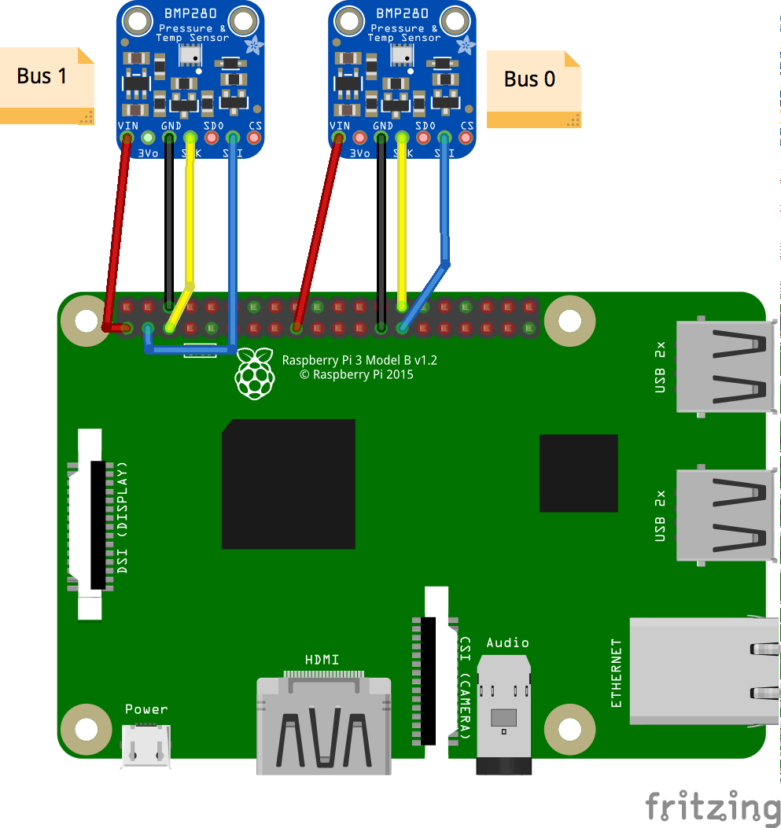
Fritzing Diagram
Use both I2C buses (No HAT or camera)
Originally used BMP085
Could have use SPI bus and chip select line to each BMP280 card

Slide 9
Proof of Concept
Back yard testing
Dunking air line into 10’ 4” vertical sewer pipe
Tab delimited values
Excel spreadsheet

Slide 10
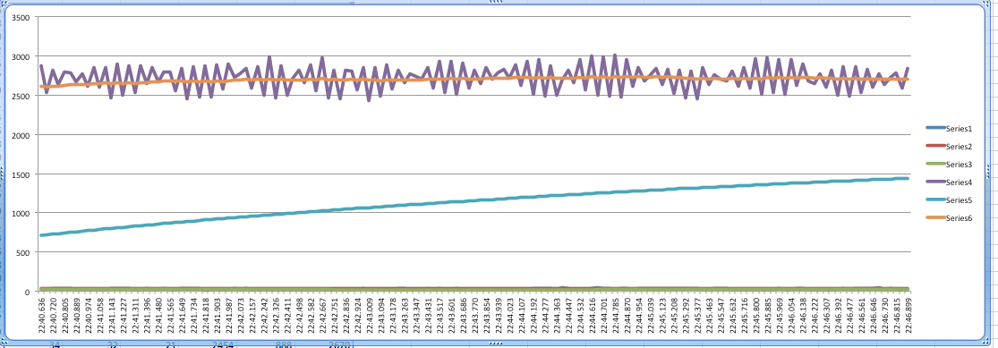
First Measurement Data

Slide 11
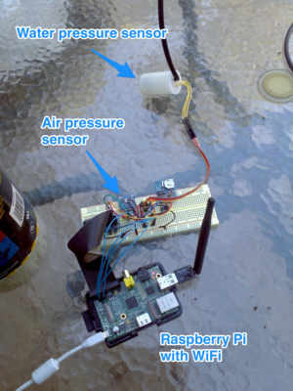
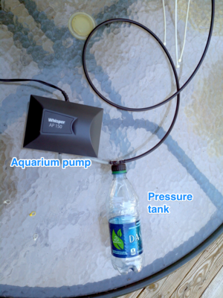
Basic Hardware

Slide 12
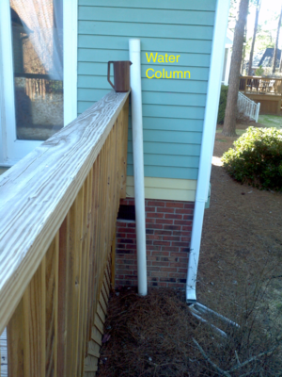
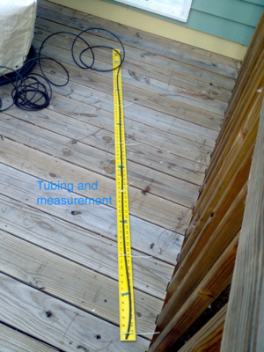
Portable Lake and Plunge Stick

Slide 13
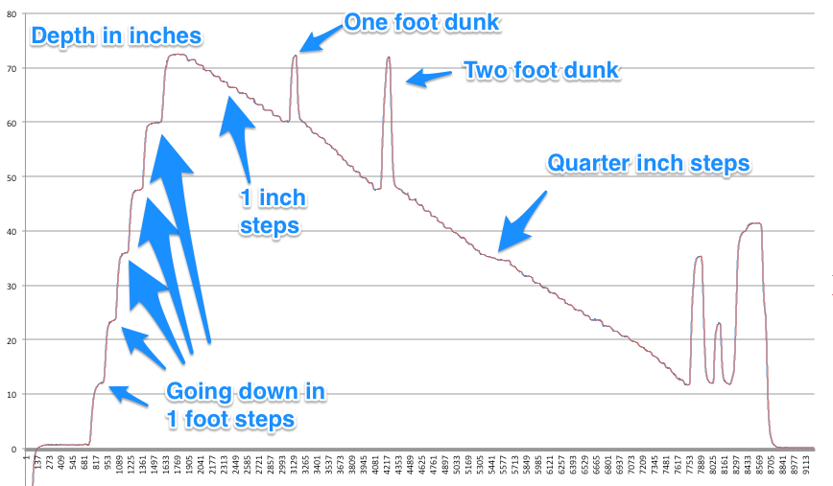
Results

Slide 14
Round 1 Real Lake Testing
python
collector: comma separated values, csv
analyzer: pyplot
plots saved as hundreds of images
intent to serve plots on an web page

Slide 15
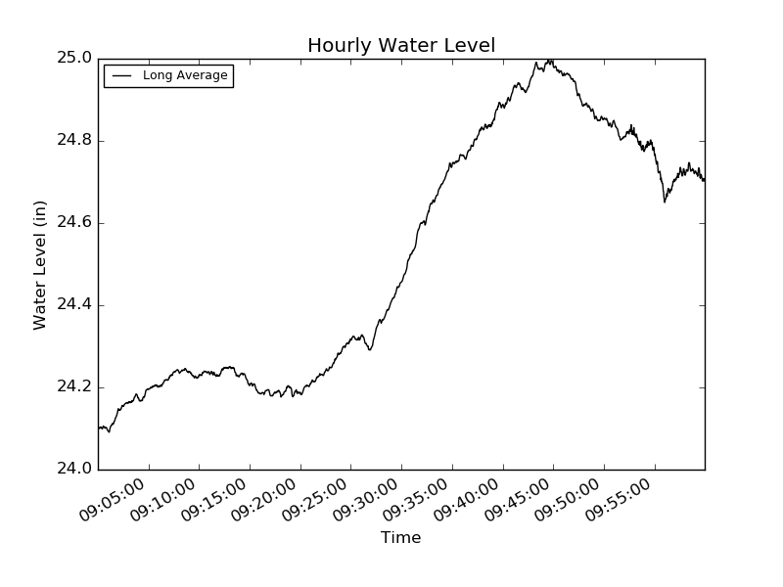
Results Hourly

Slide 16
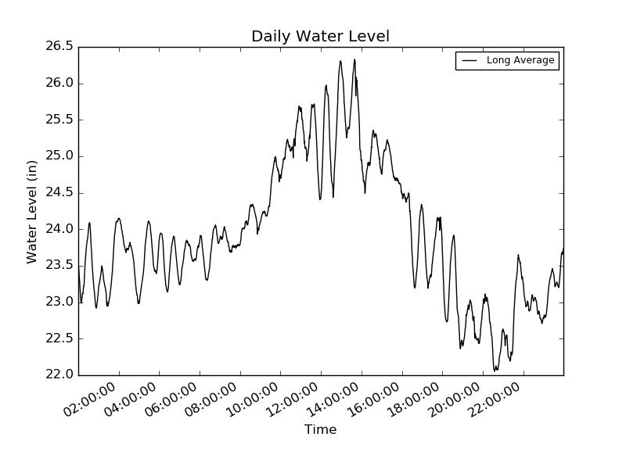
Results Daily

Slide 17
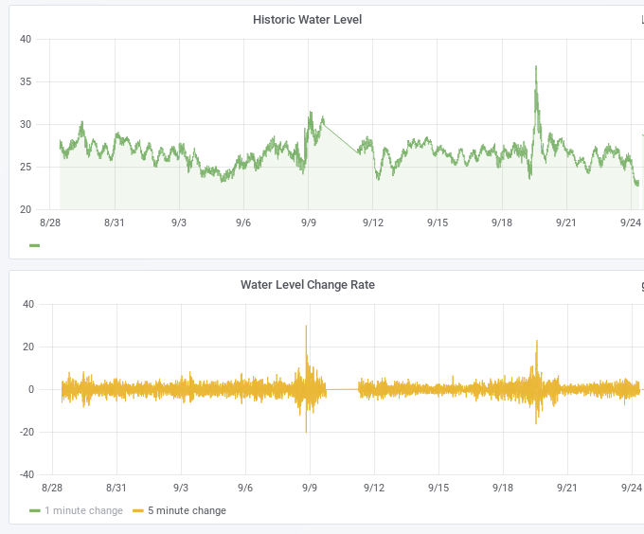
Seiche Examples

Slide 18


Slide 19


Slide 20
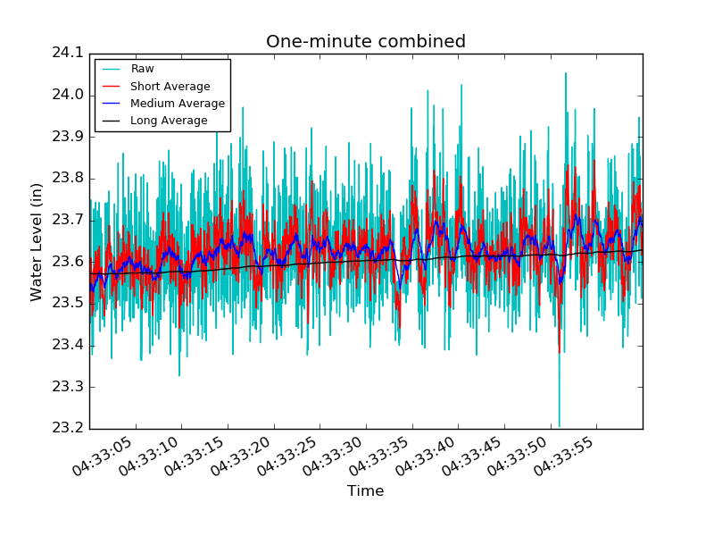
One Minute of Raw Data

Slide 21
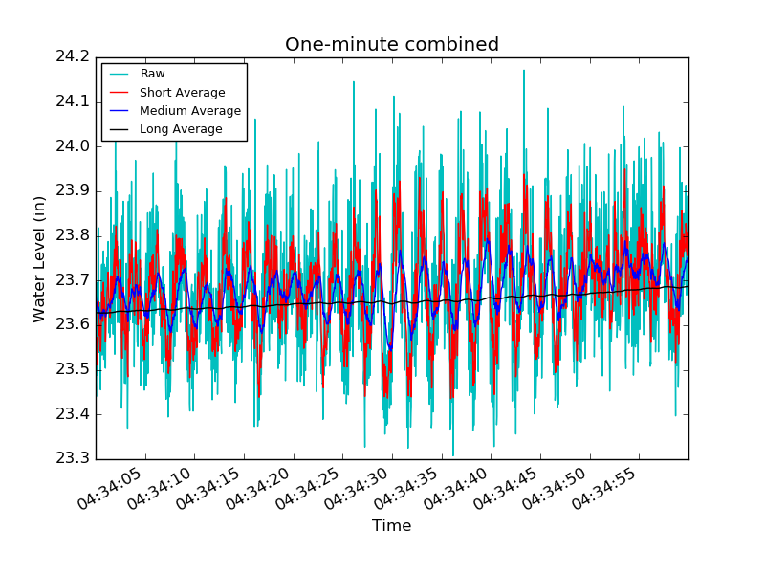
The Next Minute

Slide 22
Refine the data
running averages
  ave = (ave *(n-1) + sample) / n = ave + x
    x = (sample - ave)/n
statistics
  helps find errors
zero crossing detectors
  sea wave period and height
calculating power
  period² * height * water density * g

Slide 23
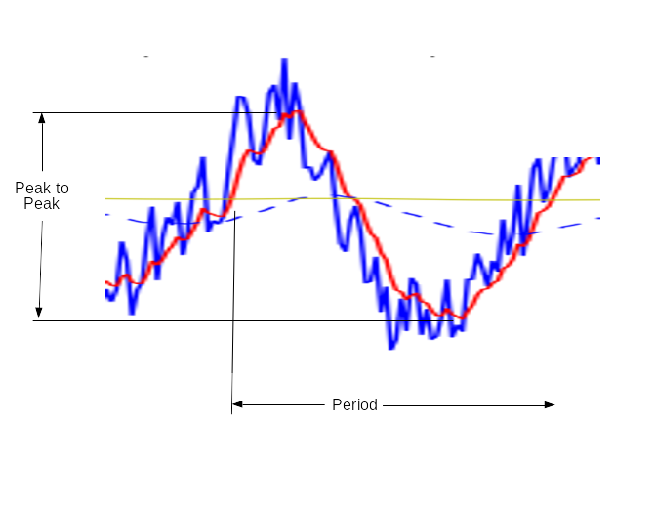
Zero Crossing Detector

Slide 24
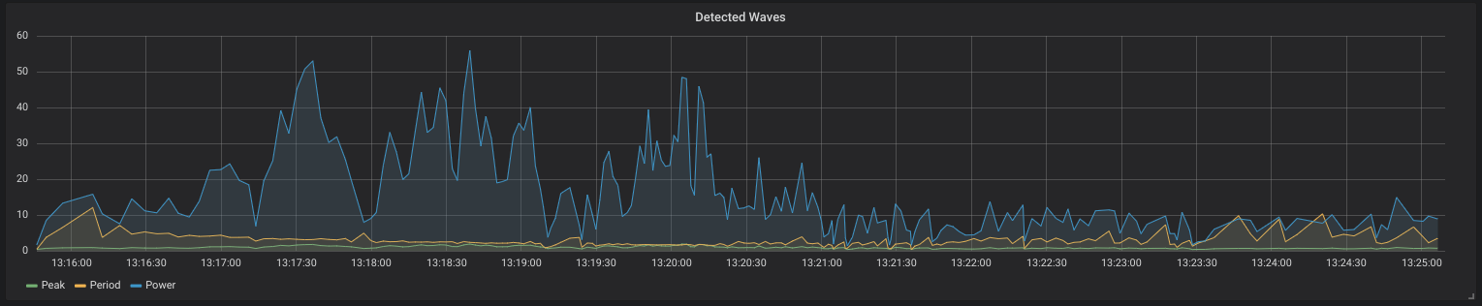
Power

Slide 25
Fourier Transform
Converts time domain into frequency domain
Do this every second and plot frequency domain changes over time
Uses a “real” FFT, not the full FFT
FFT used in signal processing
  modems >1200 baud, speech compression, MP3, QAM, QPSK, full duplex speakerphones, adaptive hearing aids, software defined radios,cellular phones, VoIP,

Slide 26
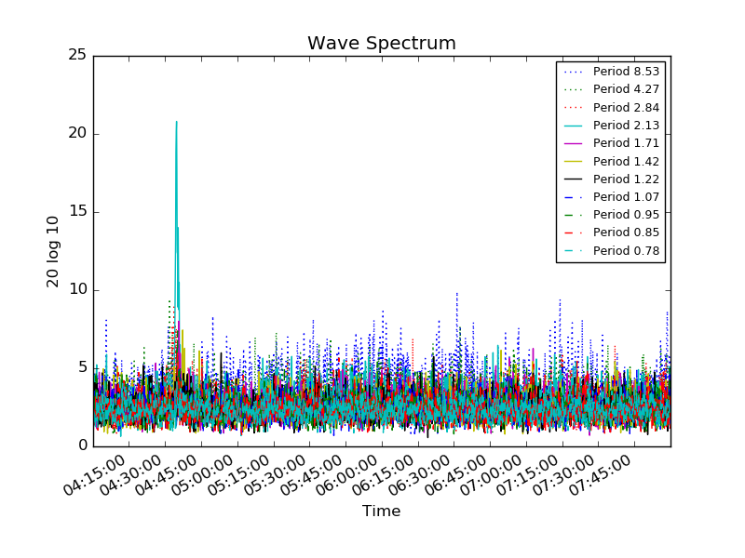
Simple 4-hour spectra

Slide 27
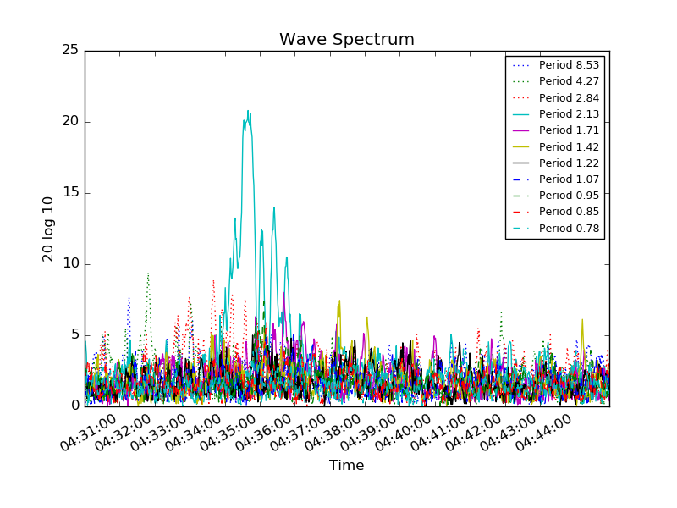
Simple 15-minute spectra

Slide 28
Round 2
intent to use JavaScript interactive plot library
mySQL
pyplot
failed database real-time test
  lagged several minutes after a couple of days of data
    30 points per second
    2,000,000 points per day
    never lost data

Slide 29
Round 3
rewrite and refactor python (again and again)
learned Python object oriented programming
influxdb for storage
Grafana for interactive plots
  thanks to Craig Tucker and Charlotte IoT
  … failed at around 6-8 million points
reduced data at input… and success!
  some evidence of data loss

Slide 30
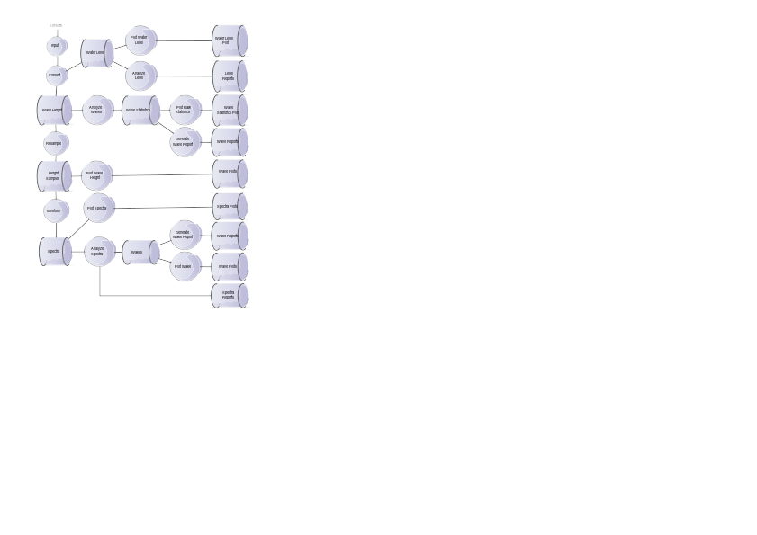
First Cut at Modularization

Slide 31
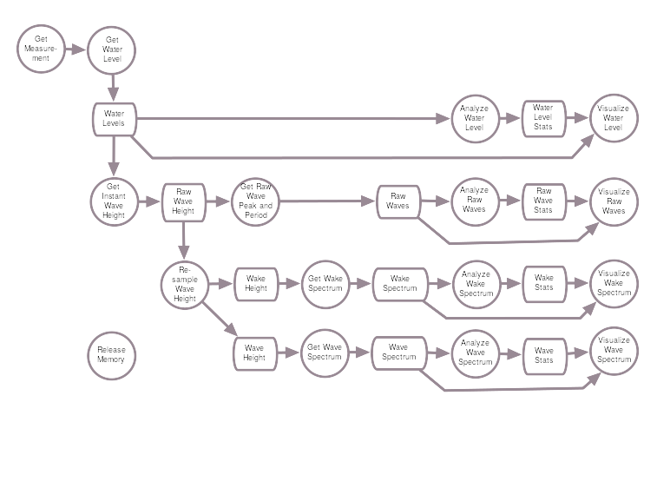
Second Cut at Modularization

Slide 32
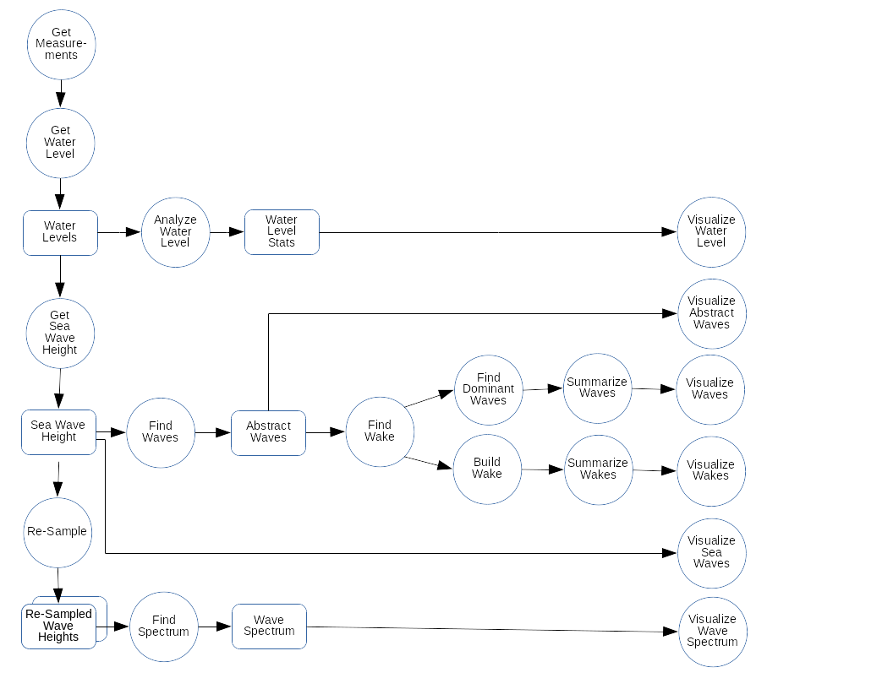
Third Cut

Slide 33
New Theories
The wavelengths produced by a boat will be less than or equal to its waterline length
  Should be able to determine size of boat
Longer wavelengths move through water faster than shorter wavelengths (AKA dispersion)
  May be able to determine distance of boat

Slide 34
Wavelength Period Speed
Wavelength (feet) | Period (s) | Speed (feet/s) | Cover 1000 feet
10’ | 1.40 | 7.16 | 2’ 19”
20’ | 1.98 | 10.12 | 1’ 39”
30’ | 2.42 | 12.39 | 1’ 21”
40’ | 2.79 | 14.31 | 1’ 10’
50’ | 3.12 | 16.00 | 1’ 2.5”

Slide 35
FFT Revisited
wake problem is inverted from most apps
  most focus on high frequency
  this focuses on low frequency
have to do an FFT for each period of interest
  buffer is fixed at 1024 samples
  change buffer period to be of interest
  resample the input stream to fill buffer

Slide 36
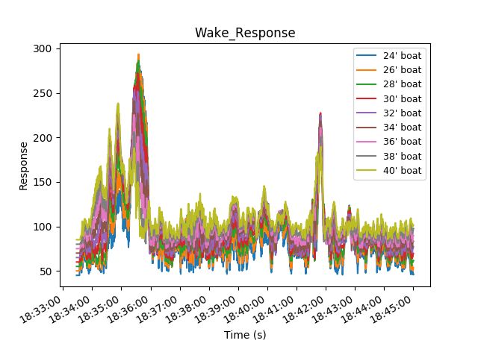
Boat Spectra (pyplot)

Slide 37
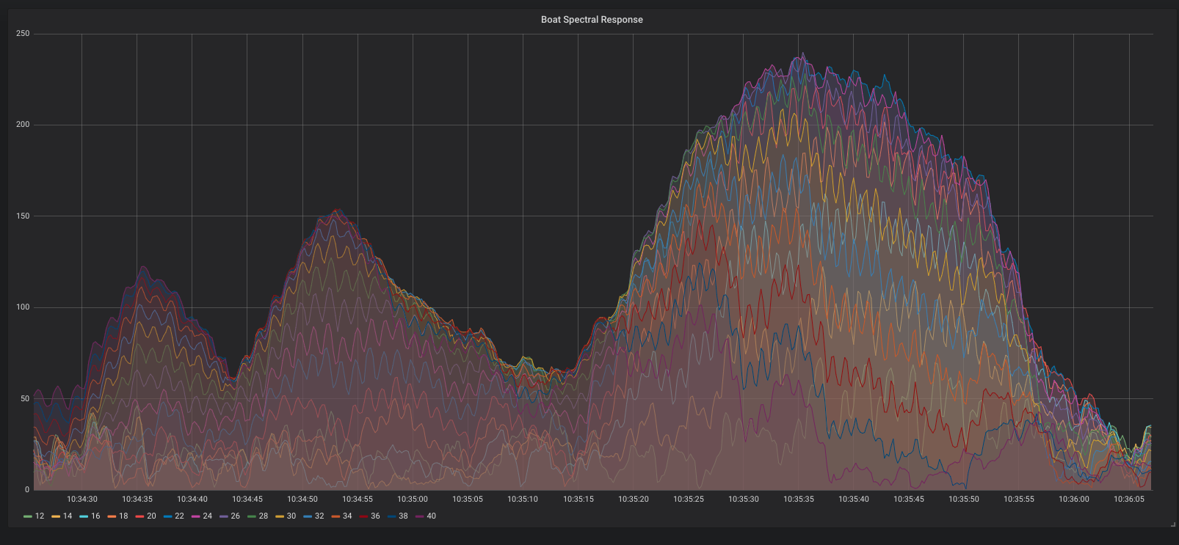
Boat Spectra (graphana)

Slide 38

Light Dispersion

Slide 39
Six minute wake spectrum

Slide 40
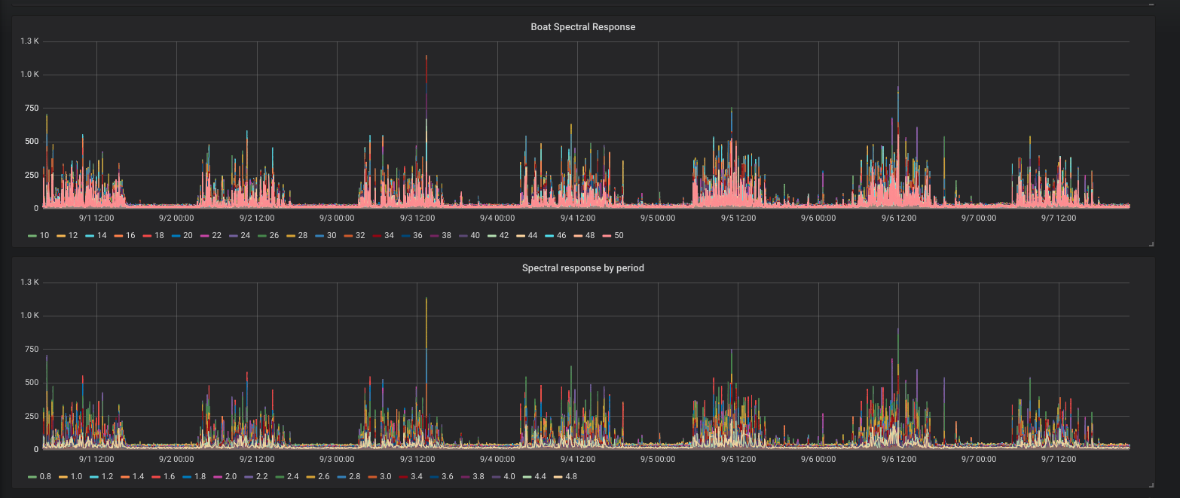
Labor day week

Slide 41
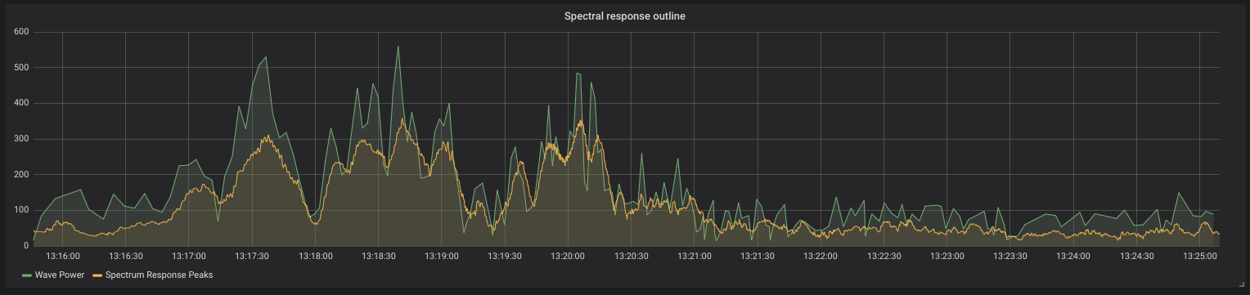
Power and Spectrum Superimposed
High correlation of simple power data with spectral data

Slide 42
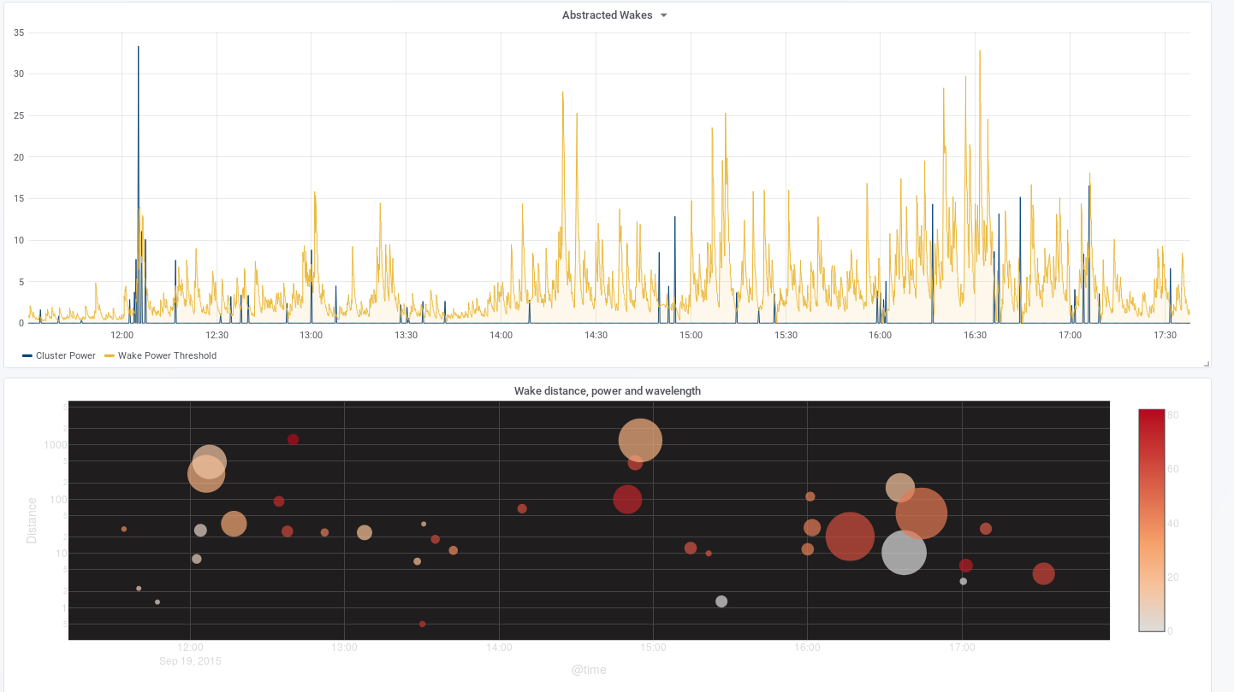
Power to Wake to Bubble

Slide 43
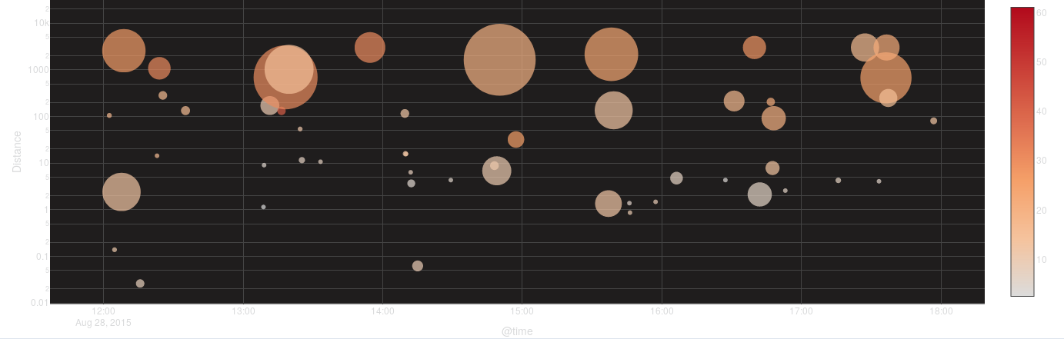
Wake Distance, Wavelength, Power
Distance is vertical (logarithmic scale)
Time is horizontal
Size is power
Color is wavelength (darker = longer)

Slide 44
Issues
wakes aren’t very high
  need direct measurement to confirm (lidar?)
long wake periods don’t seem right
wake periods observation is about 1 s
  not the 2 and 3 seconds measured
  suspect formula or apparatus error
wakes can be fairly well detected with zero-crossing and power calculation
Missing a disturbances - not coherent?

Slide 45
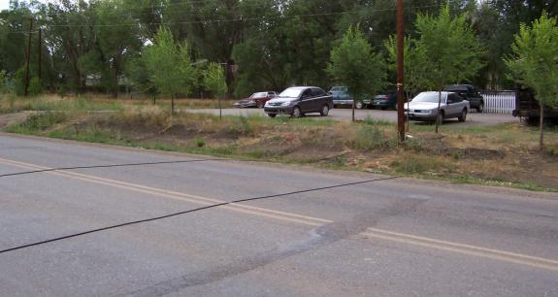
Potential Applications
Water level detector
Fluid level detector
Boating activity detector
No wake zone monitoring
Shoreline erosion monitoring
Pool monitor (micro:bit?)

Slide 46
Thank You
Questions?
Comments?

